Slide 1
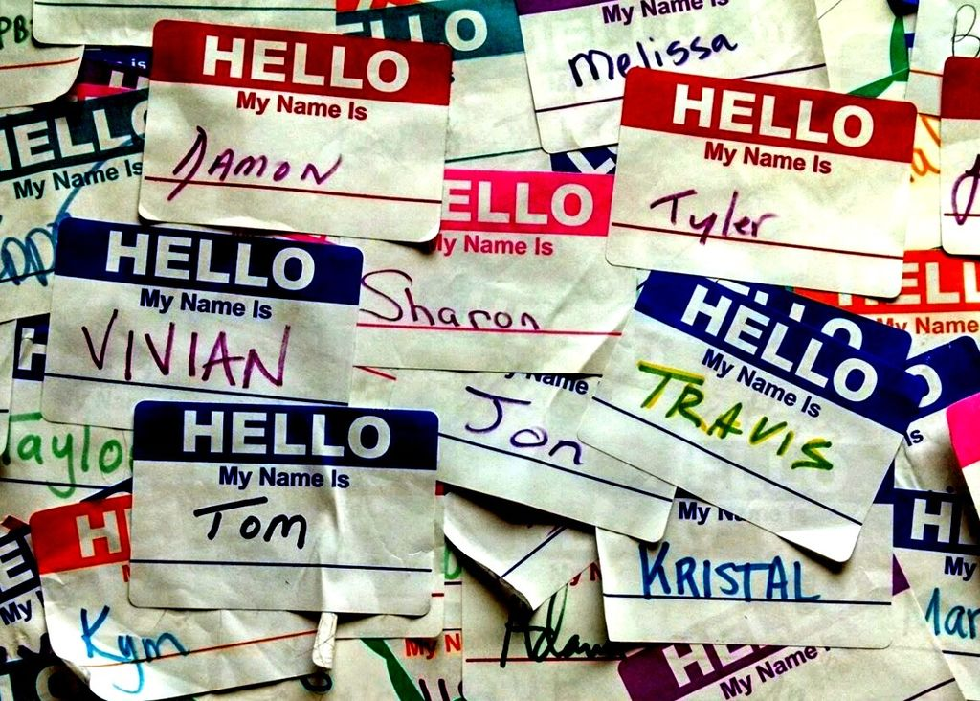
Analyzing American Baby Name Trends

Slide 2

Objective
How have American baby name tastes changed since 1920? Which names have remained popular for over 100 years, and how do those names compare to more recent top baby names? These are considerations for many new parents. After all, understanding trends and popularity is important for many businesses, too!

Slide 3
Background
The data provided by the United States Social Security Administration, which lists first names along with the number and sex of babies they were given to in each year. For processing speed purposes, we've limited the dataset to first names which were given to over 5,000 American babies in a given year. Our data spans 101 years, from 1920 through 2020.
Column | Type | Meaning
year | int | year
first_name | varchar | first name
sex | varchar | Sex of babies given first name
num | int | No. of babies of sex given first name in that year

Slide 4
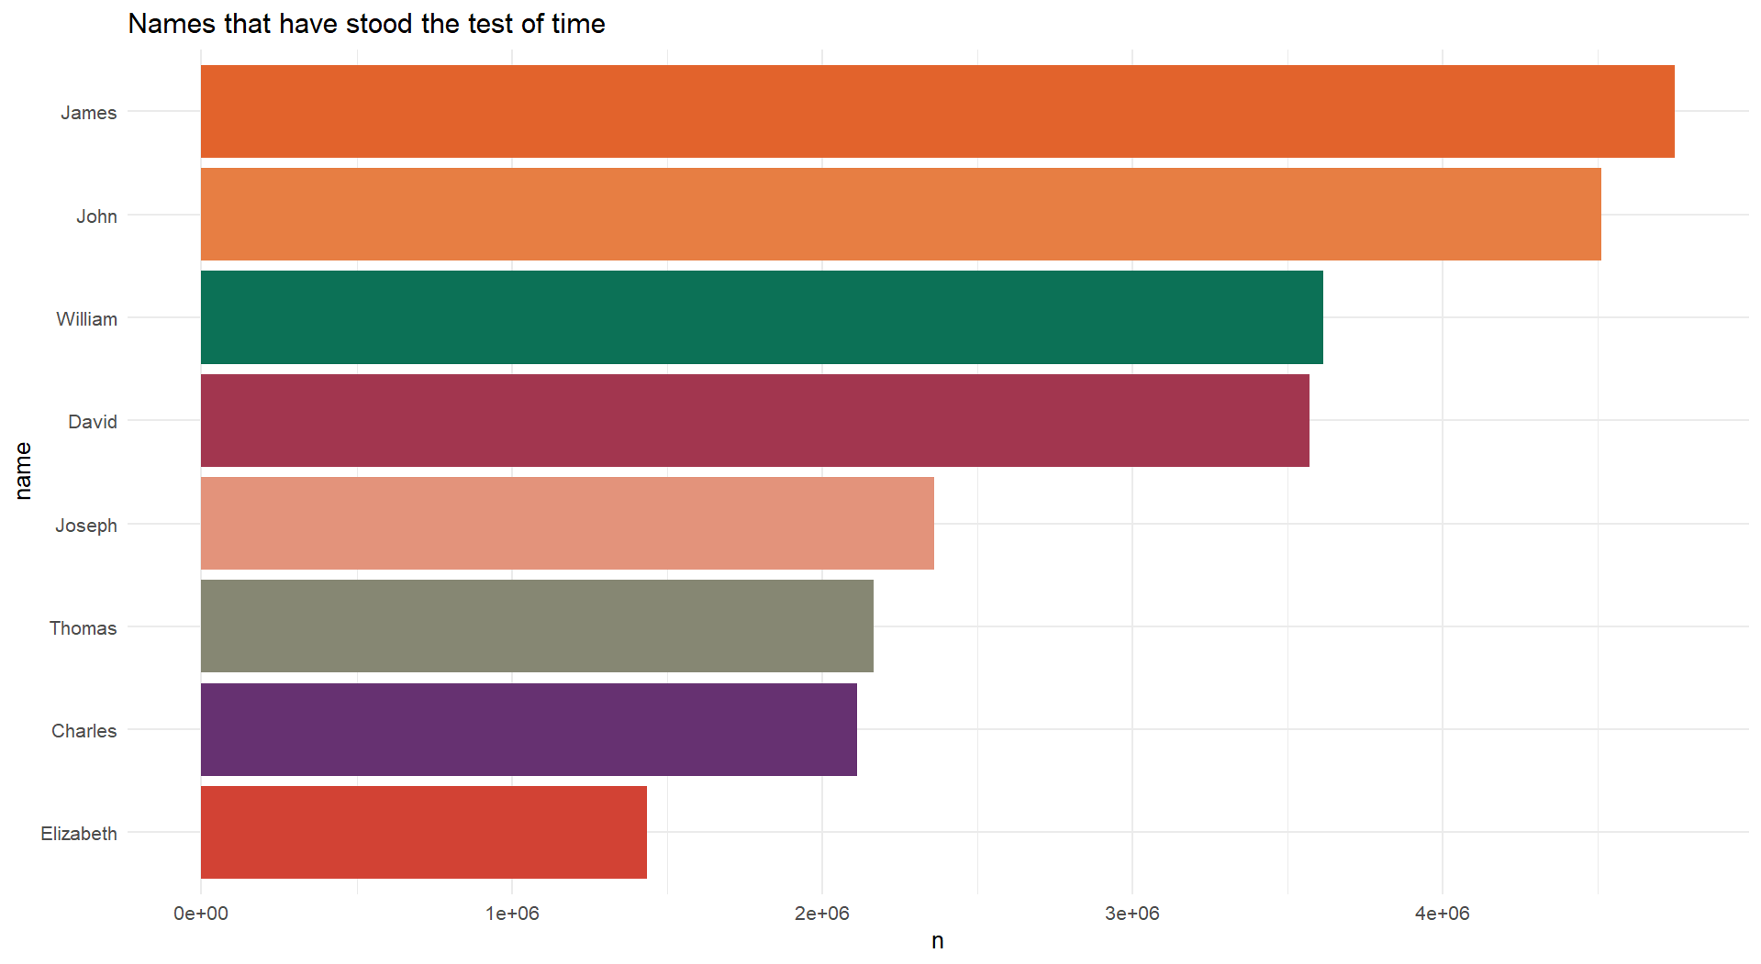
Classic American Names
It looks like there are a lot of timeless traditionally male names! Elizabeth is holding her own for the female names, too.

Slide 5
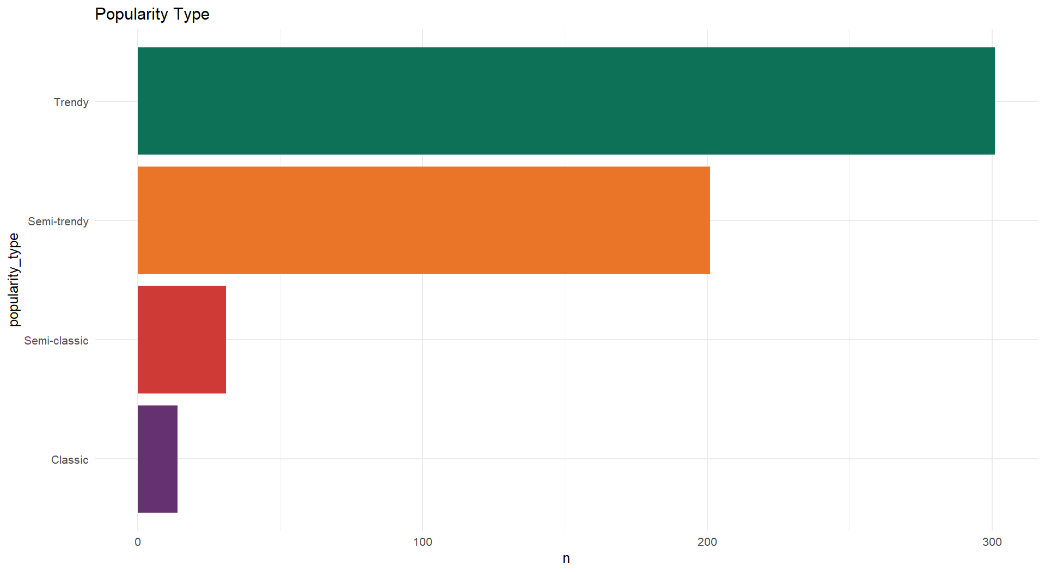
Timeless or Trendy

Slide 6
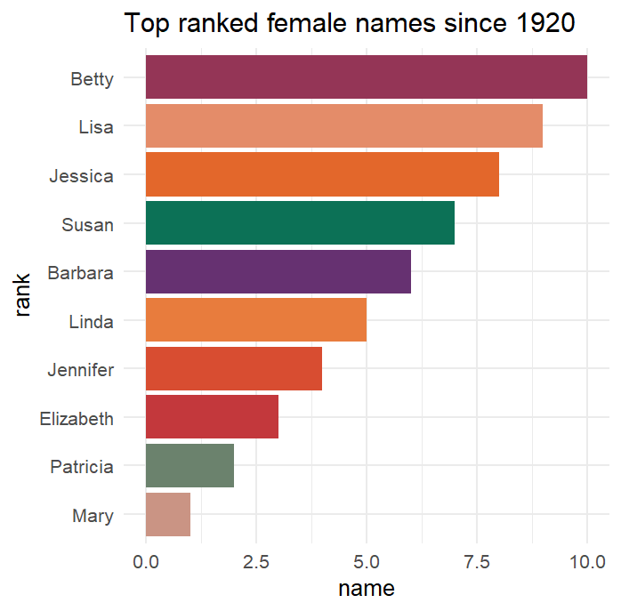
Top ranked female names since 1920

Slide 7
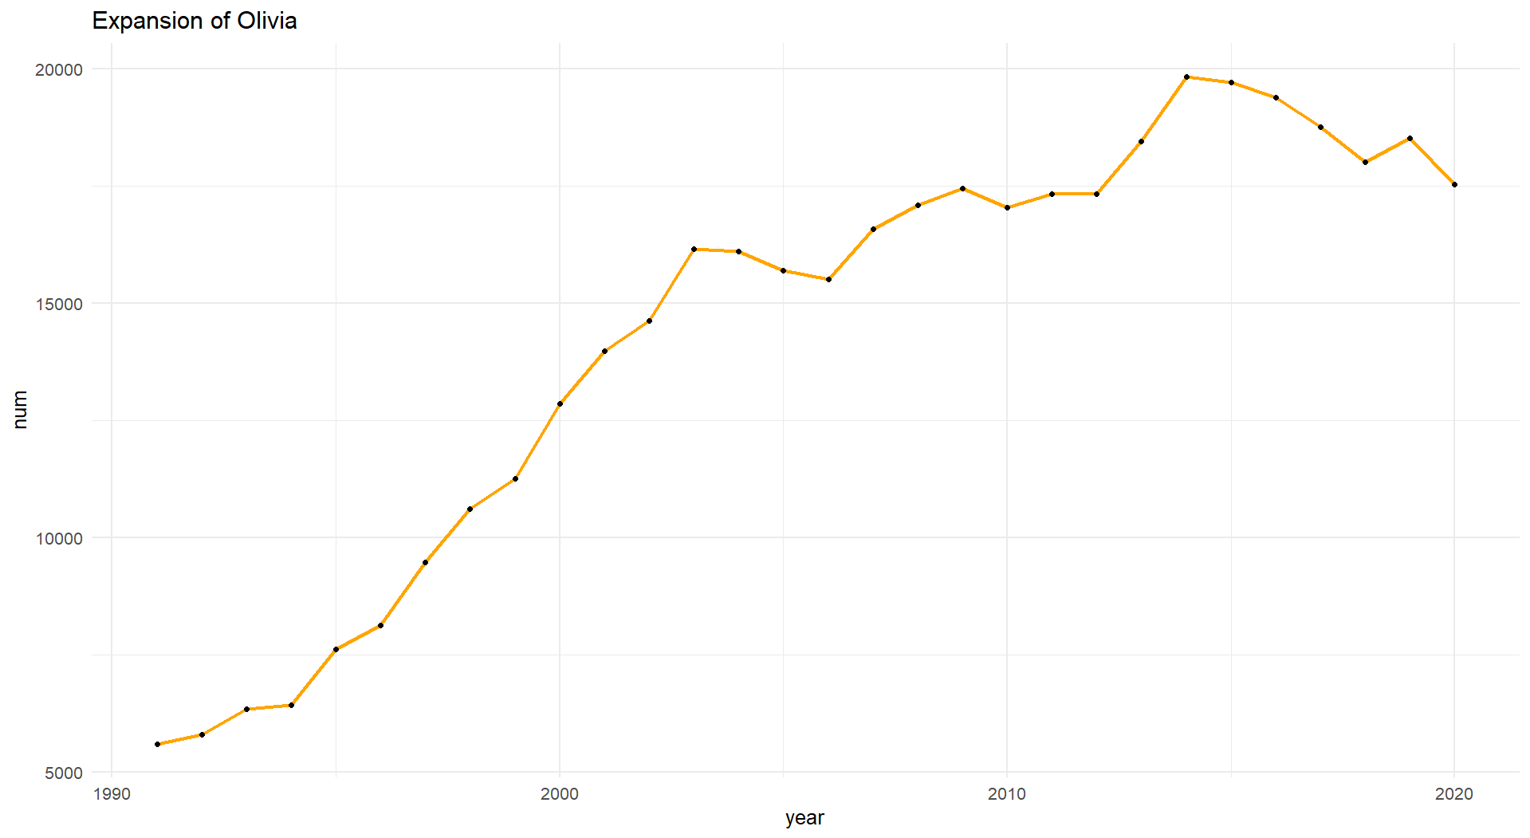
The Olivia Expansion
Based on the results in the previous task, we can see that Olivia is the most popular female name ending in 'A' since 2015. When did the name Olivia become so popular?
Let's explore the rise of the name Olivia.

Slide 8
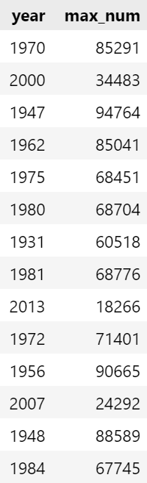
Many males with the same name
We saw in the first task that there are nine traditionally male names given to at least 5,000 babies every single year in our 101-year dataset! Those names are classics, but showing up in the dataset every year doesn't necessarily mean that the timeless names were the most popular. Let's explore popular male names a little further.
For example, in 1989, the male name given to the highest number of babies was given to 65,339 babies

Slide 9
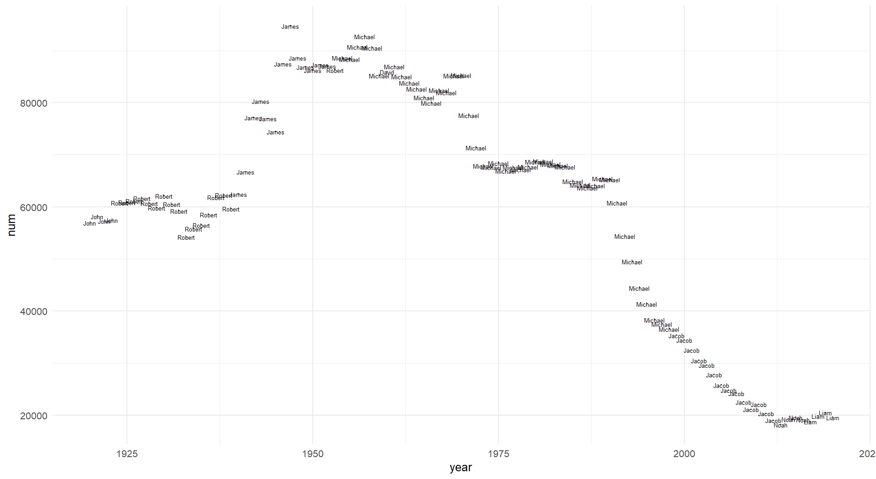
Top male names over the years
Noah and Liam have ruled the roost in the last few years, but if we scroll down in the results, it looks like Michael and Jacob have also spent a good number of years as the top name!

Slide 10
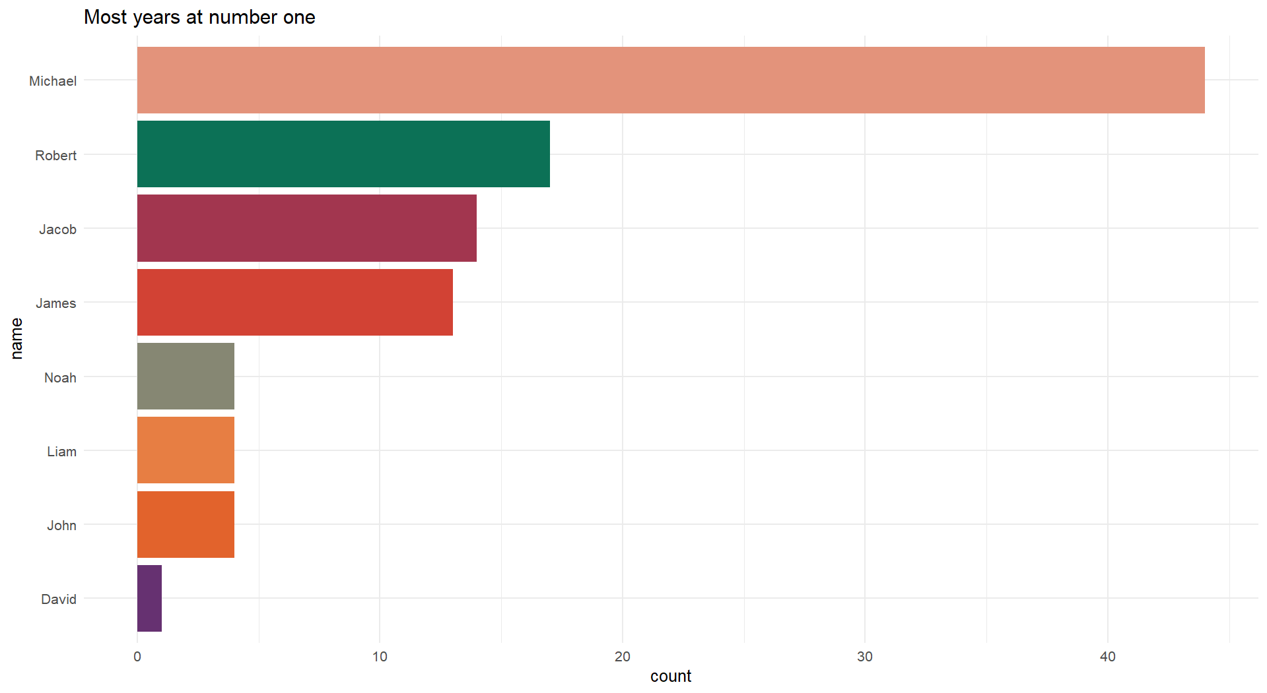
The most years at number one
Michael was at number one position for the 44 years.

